Slide 1


Scientific Machine Learning
Lecture 7: Solving forward problems using PINNs
孟旭辉
数学与统计学院数学与应用学科交叉创新研究院
办公室：欣苑2栋111室
Email：xuhui_meng@hust.edu.cn
https://github.com/XuhuiM/SciML-Course
3/29/2024

Slide 2
Contents
Residual-based adaptive sampling
Residual/gradient-based adaptive sampling
Weighted loss function

Slide 3
Contents
Residual-based adaptive sampling
Residual/gradient-based adaptive sampling
Weighted loss function

Slide 4
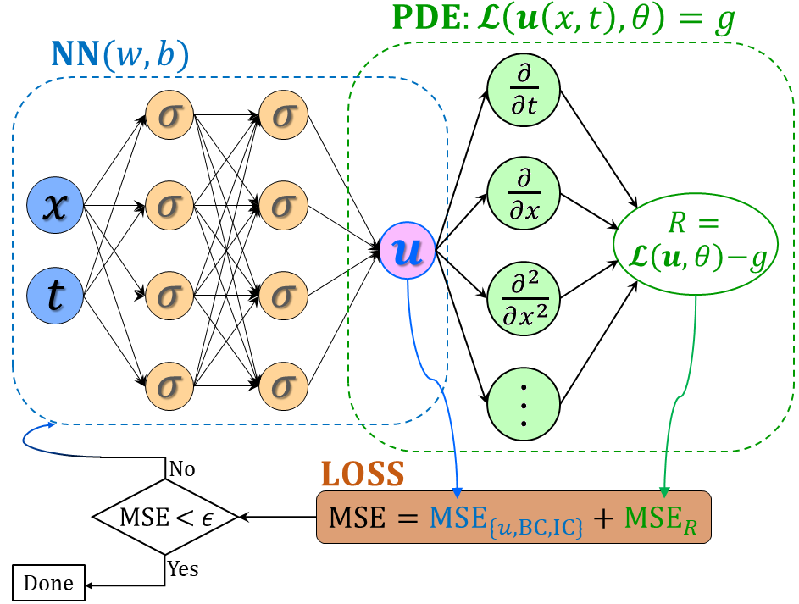
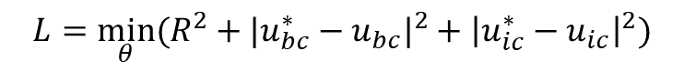

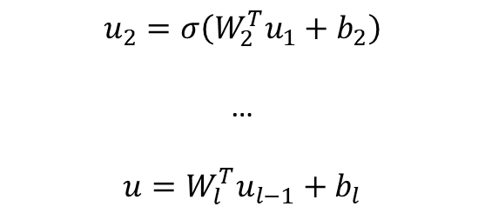

From DNNs to PINNs
$$u_{1}=σ(W_{1}^{T}X+b_{1})$$
(1)
$$u_{2}=σ\left(W_{2}^{T}u_{1}+b_{2}\right)$$
…
$$u=W_{l}^{T}u_{l−1}+b_{l}$$
(2) PDE part: Chain rule
$$∂_{t}u, ∂_{x}u, …$$
Physics-informed neural networks (PINNs)
Loss function:
Forward problem:
$$L={\min_{θ}⁡(R^{2}+|u_{bc}^{∗}−u_{bc}|}^{2}+{\left|u_{ic}^{∗}−u_{ic}\right|}^{2})$$
Inverse problem:
$$L={\min_{θ,λ}⁡(R^{2}+|u_{bc}^{∗}−u_{bc}|}^{2}+{\left|u_{ic}^{∗}−u_{ic}\right|}^{2}+{\left|u^{∗}−u\right|}^{2})$$
Raissi, et al, JCP, 2019
Meng, et al, CMAME, 2020

Slide 5
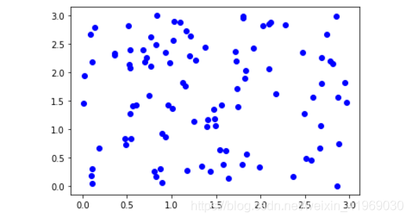
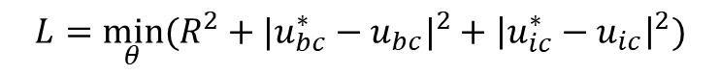

Forward problems
$$L={\min_{θ}⁡(R^{2}+|u_{bc}^{∗}−u_{bc}|}^{2}+{\left|u_{ic}^{∗}−u_{ic}\right|}^{2})$$
$$R\left(x,t\right)=0$$

Slide 6
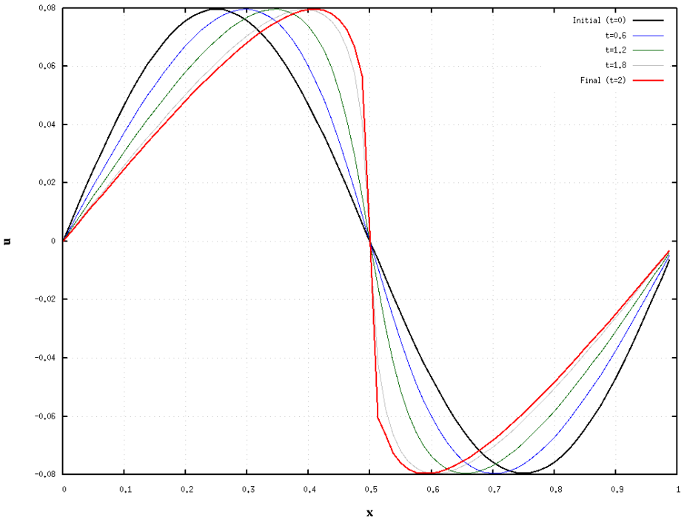
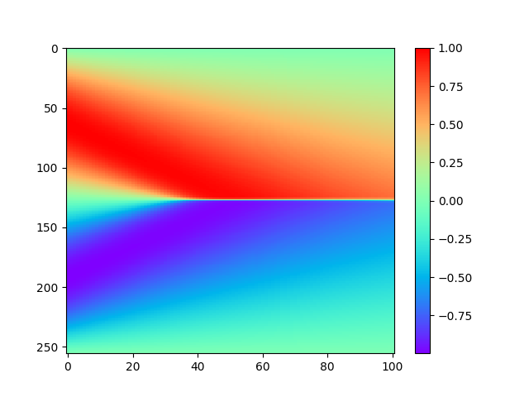
Forward problems: Burgers equation
Consider the following Burgers equation
$$u_{t}+uu_{x}=νu_{xx},x∈\left(−1,1\right), t∈\left(0,T\right],$$
$$u\left(x,0\right)=u_{0}\left(x\right), u\left(−1,t\right)=u\left(1,t\right)=0.$$
Let $u_{0}\left(x\right)=−sin⁡(πx)$

Slide 7
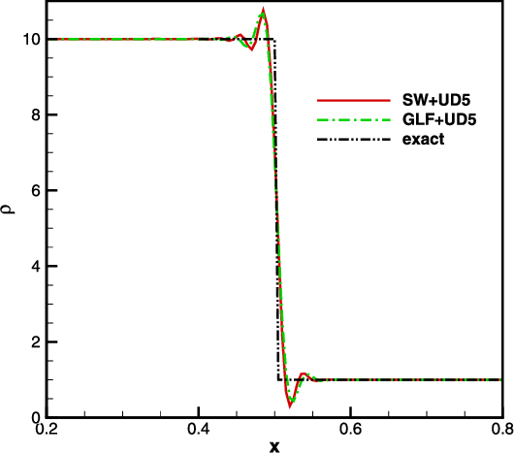
Forward problems: Burgers equation
Consider the following Burgers equation
$$u_{t}+uu_{x}=νu_{xx},x∈\left(−1,1\right), t∈\left(0,T\right],$$
$$u\left(x,0\right)=u_{0}\left(x\right), u\left(−1,t\right)=u\left(1,t\right)=0.$$
Let $u_{0}\left(x\right)=−sin⁡(πx)$

Slide 8
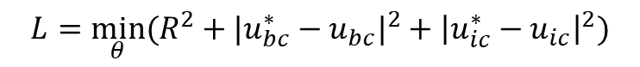

Residual-based adaptive sampling
$$L={\min_{θ}⁡(R^{2}+|u_{bc}^{∗}−u_{bc}|}^{2}+{\left|u_{ic}^{∗}−u_{ic}\right|}^{2})$$
$$R\left(x,t\right)=0$$
Step 1.
Step 2.
Randomly select # testing points R(x,t) = 0 ?
Step 3.
Add new training data at locations R(x,t) > 0
Lu, et al, SIREV, 2021

Slide 9
Residual-based adaptive sampling
Lu, et al, SIREV, 2021

Slide 10
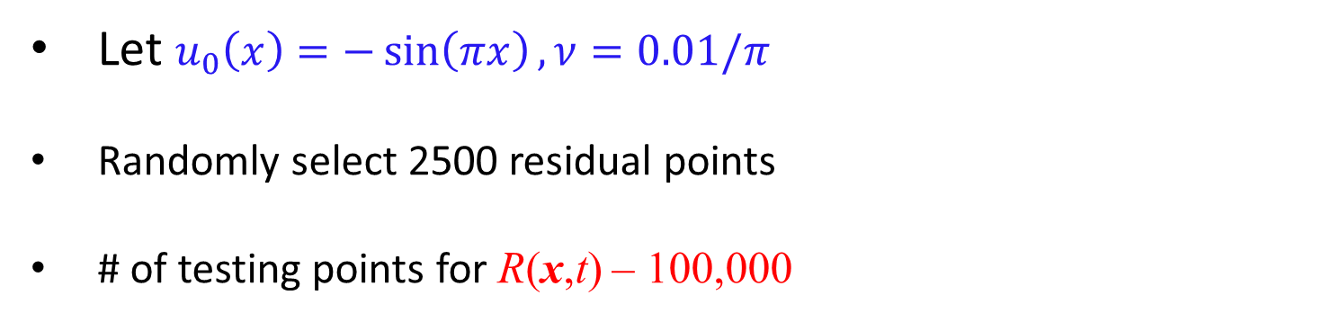
Forward problems: Burgers equation
Consider the following Burgers equation
$$u_{t}+uu_{x}=νu_{xx},x∈\left(−1,1\right), t∈\left(0,T\right],$$
$$u\left(x,0\right)=u_{0}\left(x\right), u\left(−1,t\right)=u\left(1,t\right)=0.$$
Let $u_{0}\left(x\right)=−\sin\left(πx\right), ν=0.01/π$
Randomly select 2500 residual points
# of testing points for R(x,t) – 100,000
Lu, et al, SIREV, 2021

Slide 11
Residual-based adaptive sampling
Lu, et al, SIREV, 2021

Slide 12
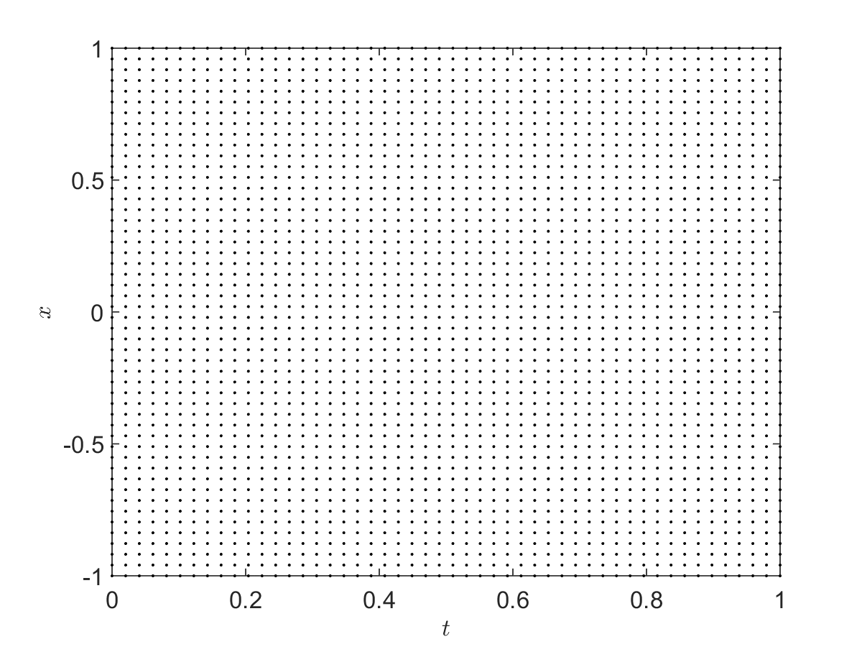
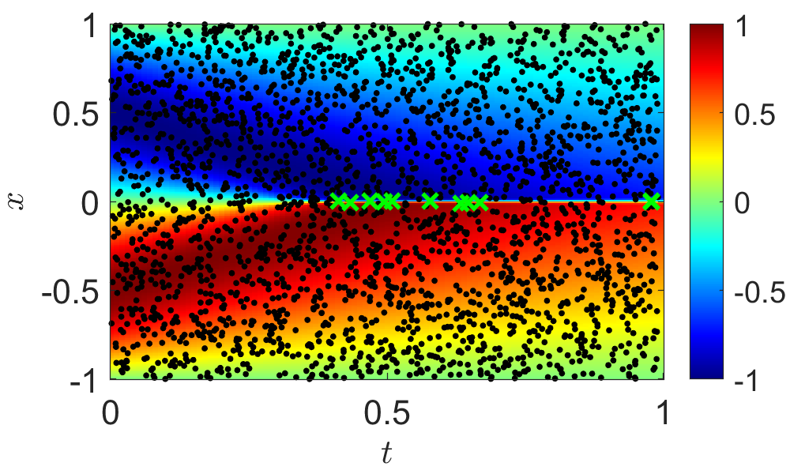
Residual-based adaptive sampling
Lu, et al, SIREV, 2021

Slide 13
Residual-based adaptive sampling: 2D Burgers equations
Re=5000
Randomly select 210 residual points
0.2, 0.5, 1.0
Lu, et al, SIREV, 2021

Slide 14
Residual-based adaptive sampling
Easy to implement
Computationally efficient
Effective for both spatial and temporal domain

Slide 15
Contents
Residual-based adaptive sampling
Residual/gradient-based adaptive sampling
Weighted loss function

Slide 16
Residual/gradient-based adaptive sampling
Mao & Meng, arxiv, 2023

Slide 17
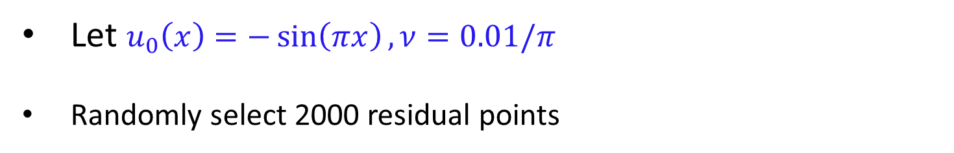
Forward problems: Burgers equation
Consider the following Burgers equation
$$u_{t}+uu_{x}=νu_{xx},x∈\left(−1,1\right), t∈\left(0,T\right],$$
$$u\left(x,0\right)=u_{0}\left(x\right), u\left(−1,t\right)=u\left(1,t\right)=0.$$
Let $u_{0}\left(x\right)=−\sin\left(πx\right), ν=0.01/π$
Randomly select 2000 residual points
Mao & Meng, arxiv, 2023

Slide 18

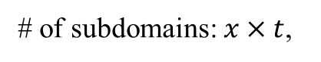
Forward problems: Burgers equation
# of subdomains: $x×t$,
# of quadrature points: $x×t$
Mao & Meng, arxiv, 2023

Slide 19
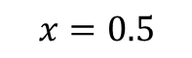
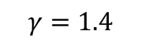
Forward problems: 1D Euler equation
$$γ=1.4$$
$$x=0.5$$
Mao & Meng, arxiv, 2023

Slide 20

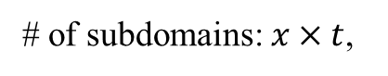
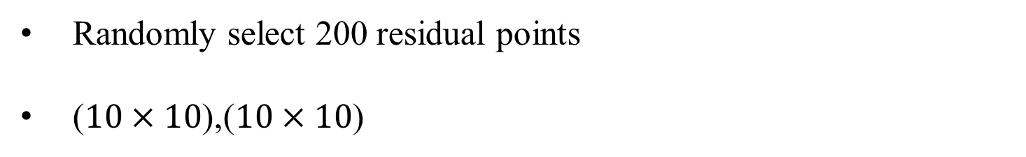
Forward problems: 1D Euler equation
Randomly select 200 residual points
($10×10$),($10×10$)
# of subdomains: $x×t$,
# of quadrature points: $x×t$
Mao & Meng, arxiv, 2023

Slide 21
Residual/gradient-based adaptive sampling
Mao & Meng, arxiv, 2023

Slide 22
Forward problems: 1D Euler equation
Mao & Meng, arxiv, 2023

Slide 23
Forward problems: 1D Euler equation
Mao & Meng, arxiv, 2023

Slide 24
Forward problems: 9-dimensional Poisson equation
d = 9
Mao & Meng, arxiv, 2023

Slide 25

Forward problems: Complex geometry
$$x,y∈[−1,1]$$
Mao & Meng, arxiv, 2023

Slide 26
Forward problems: Complicated Boundaries
Mao & Meng, arxiv, 2023

Slide 27
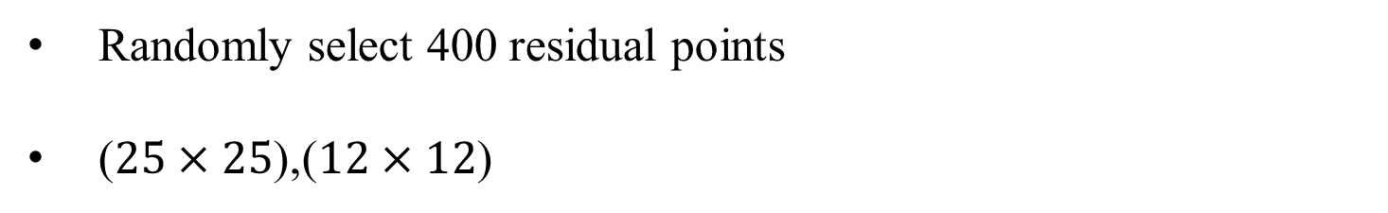
Forward problems: Complicated Boundaries
Randomly select 400 residual points
($25×25$),($12×12$)
Mao & Meng, arxiv, 2023

Slide 28
Forward problems: Complicated Boundaries
Randomly select 400 residual points
($25×25$),($12×12$)
Mao & Meng, arxiv, 2023

Slide 29
Contents
Residual-based adaptive sampling
Residual/gradient-based adaptive sampling
Weighted loss function

Slide 30
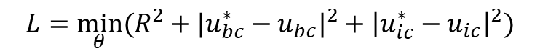
Weighted loss function
$$L={\min_{θ}⁡(R^{2}+|u_{bc}^{∗}−u_{bc}|}^{2}+{\left|u_{ic}^{∗}−u_{ic}\right|}^{2})$$
$$L={\min_{θ}⁡({w_{R}R}^{2}+w_{bc}|u_{bc}^{∗}−u_{bc}|}^{2}+w_{ic}{\left|u_{ic}^{∗}−u_{ic}\right|}^{2})$$

Slide 31
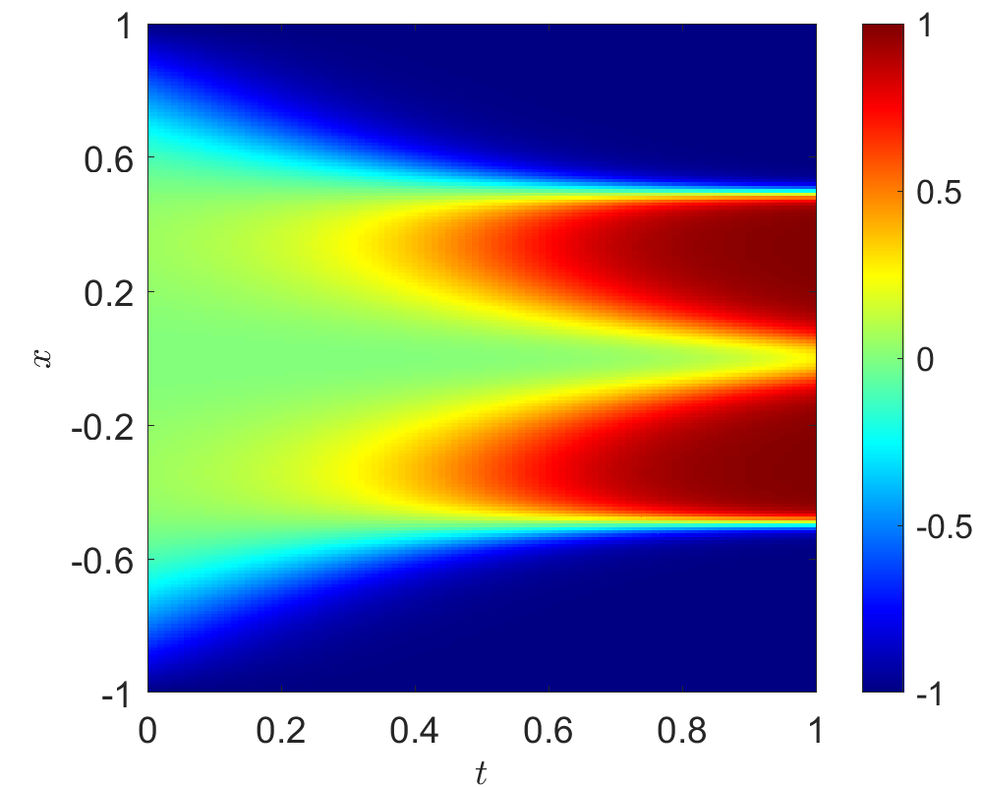
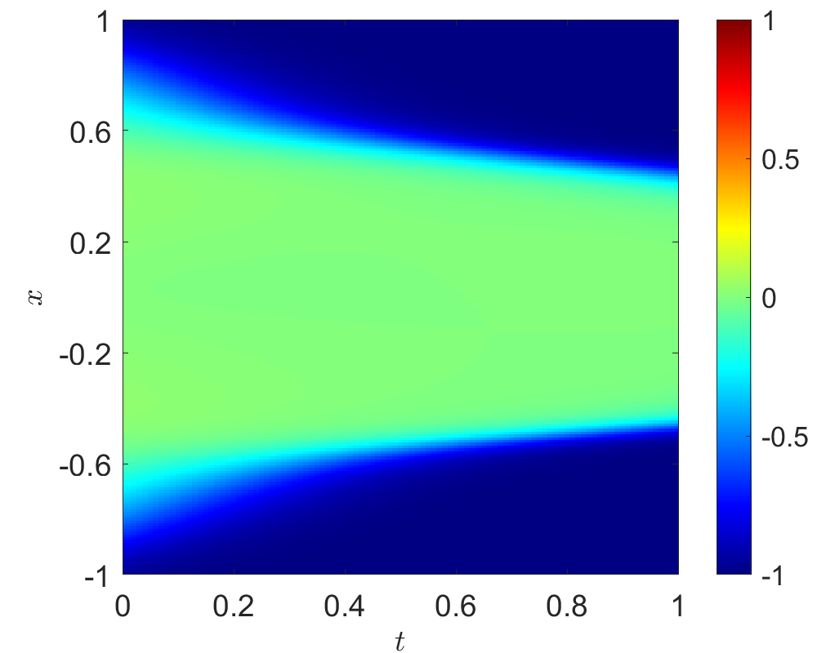
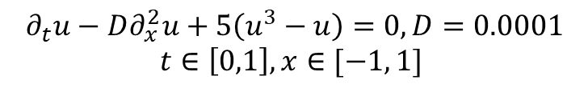
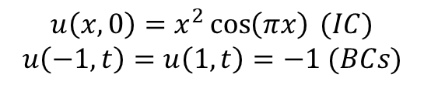
Weighted loss function
$$∂_{t}u−D∂_{x}^{2}u+5\left(u^{3}−u\right)=0, D=0.0001$$
$$t∈\left[0,1\right], x∈[−1, 1]$$
$$u\left(x,0\right)=x^{2}\cos\left(πx\right) (IC)$$
$$u\left(−1,t\right)=u\left(1,t\right)=−1 (BCs)$$
DNN: 4 hidden layers with 128 neurons per layer
20,000 random points for residual
200 uniform points for initial conditions
100 uniform points for boundary conditions

Slide 32
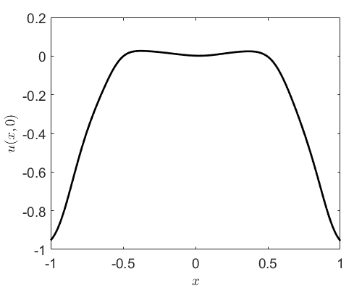
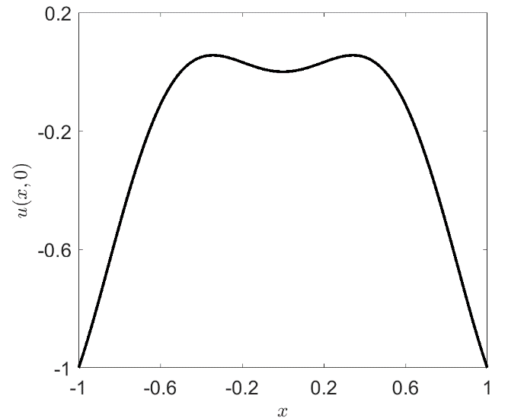
Weighted loss function

Slide 33
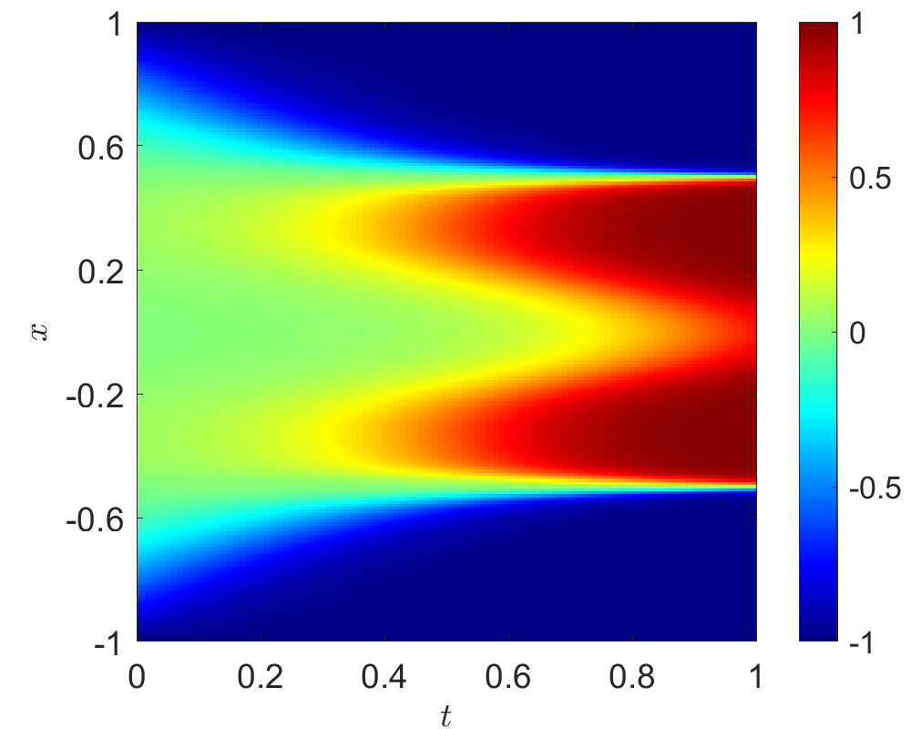
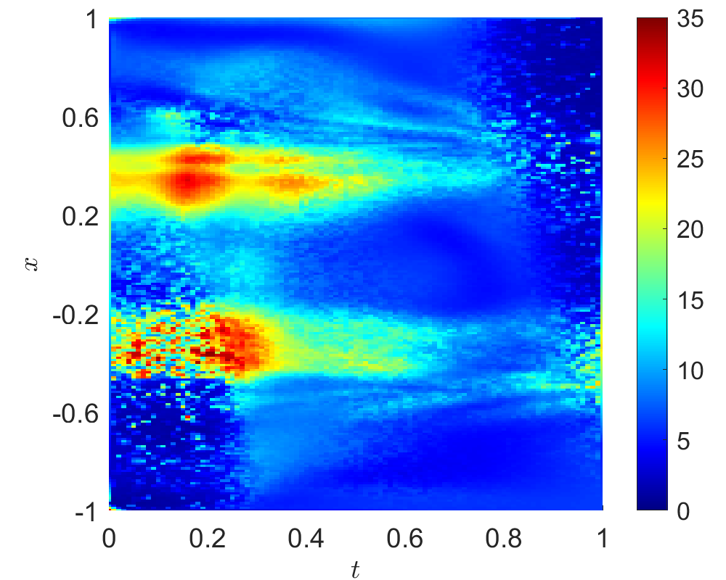
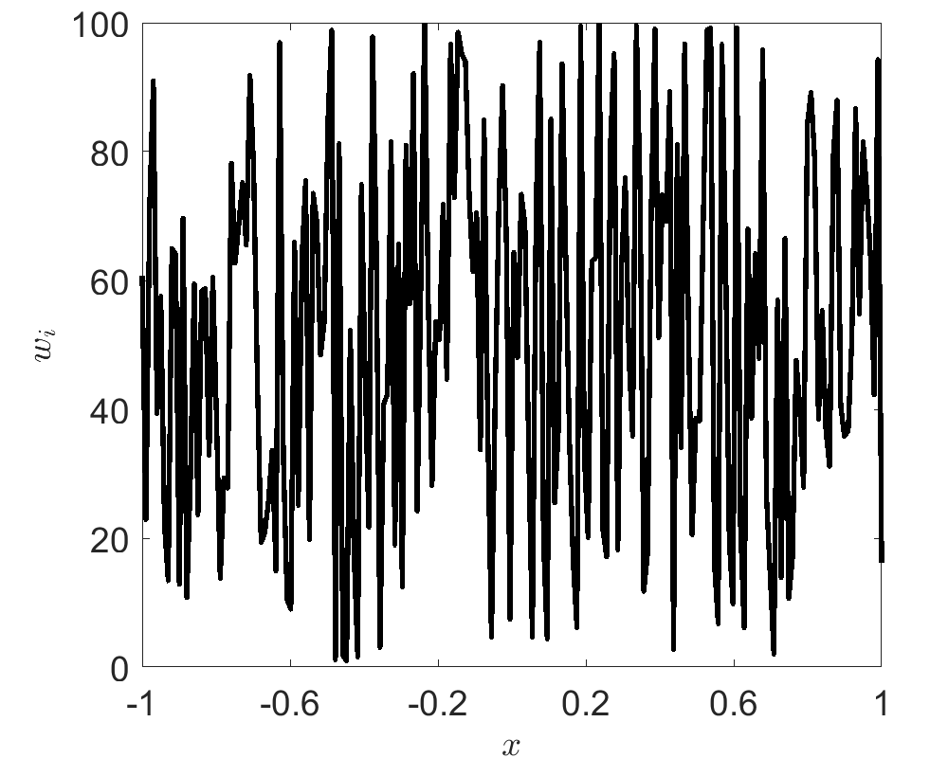
Weighted loss function
$$L={\min_{θ}⁡({w_{R}R}^{2}+w_{bc}|u_{bc}^{∗}−u_{bc}|}^{2}+w_{ic}{\left|u_{ic}^{∗}−u_{ic}\right|}^{2})$$

Slide 34

Thank you for your attention!

